Slide 1
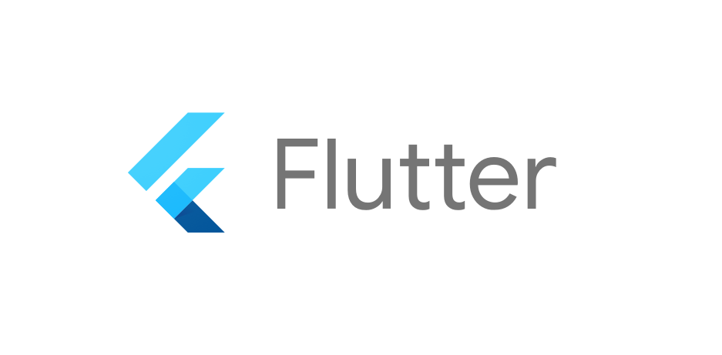
Top 7 Reasons Flutter is setting the Trend in Mobile App Development
Numerous businesses and brands all over the world have already started using Flutter to meet their diverse marketing goals. From coding to design, everything can be done on a mobile device – eliminating the need for cross-platform programming. In the early part of 2017, Google announced its new mobile UI framework called “Flutter” and it has been taking the mobile application development industry by storm ever since. Flutter is Google’s mobile UI tool that works effectively for both Android and iOS app development. The tool is developed mainly for use with the programming language Dart for cross-platform development.
Flutter offers the best platform for building cross-platform mobile applications. Their intuitive and robust framework allows you to stay focused on real business goals while Flutter takes care of the rest. It has seen phenomenal growth in the last few months. Even if it is still in its early stages, many developers of the industry believe that it will soon take the lead from the giants when it comes to cross-platform development. Mobile app development has been made easy with it. Let’s see the reasons how flutter is setting up the trends in 2021.
Flutter offers Easy App Testing for Mobile App Development
Flutter implements a one-code-based approach, allowing developers to develop frontend and backend in a single place, making it faster and simpler. It is not just easy for beginners to learn, but it also allows experienced devs to create a high-performance mobile app. For Android app
development, flutter enables easy testing and hence helps the developers to create and insert functions easily. This makes it simpler to use, and in turn, speeds up the development process. In
addition to this, the one code can be used again with different plugins, allowing the developers to reuse it. Tested through simple quality assurance tests, these applications ensure that they fulfil the
function for which they were intended.
Widgets
To run and operate an application, one needs to have basic knowledge of the
widgets. Flutter integrated applications are known for providing a wide range of widgets while providing an unmatchable experience. This also includes navigation, scrolling, fonts and so on.

Slide 2
Widgets are nothing but software components that help in designing a mobile app or a website. They are specifically called widgets because they add more functionality and improve the overall interface of an application. They are also very useful when used in combination with other widgets. In-app development, widgets help to make applications more clear. Widgets are a very important part of the application interface. Flutter apps provide lots of customizable widgets.
Easy maintenance
Flutter’s modular architecture is easy to understand and maintain. Developers can use the hot reload feature for quick app optimization, and Google’s plugin-based approach makes it possible to extend the capabilities of Flutter apps with ease. The simplicity and speed of Flutter development make it a pleasure to use. This same code can be reused on all operating systems, making it a simple task to develop for iOS and Android app development with the same codebase. It has a simple code, with a single code that helps to develop the user interface and plays a crucial role in fixing
bugs. Flutter is very easy to use, so there is no need to spend extra money on machines for programmers. It is also available for free, so you can start using it without any hassle.
MVP For Investors
The Flutter framework is a program for creating cross-platform native applications for mobile devices. The Flutter program helps developers by allowing them to create an app with only one code instead of writing two separate codes for android and iOS. It saves time and effort on creating prototypes and ensures that the MVP(Model View Presenter) development process is easier to complete. Flutter lets you create your next mobile app so that you can share your minimum viable product with investors. Skip the time and resources needed to develop and test prototypes by using Flutter, which is faster. Mobile app development makes it easy to present MVP in front of investors.
Easy Programming Language
The Dart language is a high-level programming language developed by Flutter. It is scalable, fast, and simple to understand. It’s a one-source programming language that can be used for both web and mobile apps development. It is the Swift language, without Apple everywhere. Since Dart is Google’s creation, it feels tailored to work with their technical products, such as Flutter and Polymer. Dart is made so that programs can easily be tested, analysed and debugged without any cost. Dart is specifically designed in the easiest form to be used by senior as well as junior developers. It provides long-term support for advanced widgets, instructions for compiling templated apps, and employs third-party analyser inspection.
Quick Reloading
`Hot Reloading` is the process through which your Flutter application gets updated automatically as you change the code. It affects runtime. You can see and achieve the impact through a tool called “Dart Observatory”. With this tool, you can see the changes in the code itself and not just on the device. In-app development, this feature helps the developers a lot. This saves a lot of hassle when it comes to dealing with logistics. For instance, if you are working on a screen where you do not have

Slide 3
internet. It would allow the developers to not just move quickly but also solve problems
efficiently. Flutter can solve the problems of the app development industry and help in the growth of mobile applications by using its amazing features.
7. A single code will work
A compelling reason for every developer to learn Flutter is its unique approach towards mobile app development. It is not merely another cross-platform mobile app development tool. This is more than that. Developers do not need to create two separate codes, explain the UI and other systems separately, and manage two separate codebases in parallel. With Flutter, developers can write the source code only once. That means more time to concentrate on other complex parts of the application. Flutter removes the need to write separate code for both platforms, by compiling once to natively render across both Android and iOS.
Conclusion
If you have a clear vision of how your app is going to look like, it is not going to be easy to get over with the designer’s creativity. But more than that, you need an expert mobile developer to make sure that you can customize the user interface according to your needs. Mobile app development is a tricky subject. You might complicate things fast depending on the framework and libraries you use to build your app.
However, the flutter mobile app development framework is a different story altogether. Flutter lets you build a cross-platform app using a single programming language called Dart. Flutter uses the same core software development kit (SDK) for both iOS and Android platforms and the apps developed using Flutter run natively on each of these platforms.
If you wish to develop something using Flutter or maybe another language, we are happy to help. Just connect with us here.

